Slide 1
Leak Detection (LD) SRP Update
Under Surveillance, Operations, and Monitoring (SOM)
Nikolaos (Nikos) Salmatanis
Senior Leak Detection Engineer, Chevron
Fall 2025 Meeting
October 22nd 2025

Slide 2
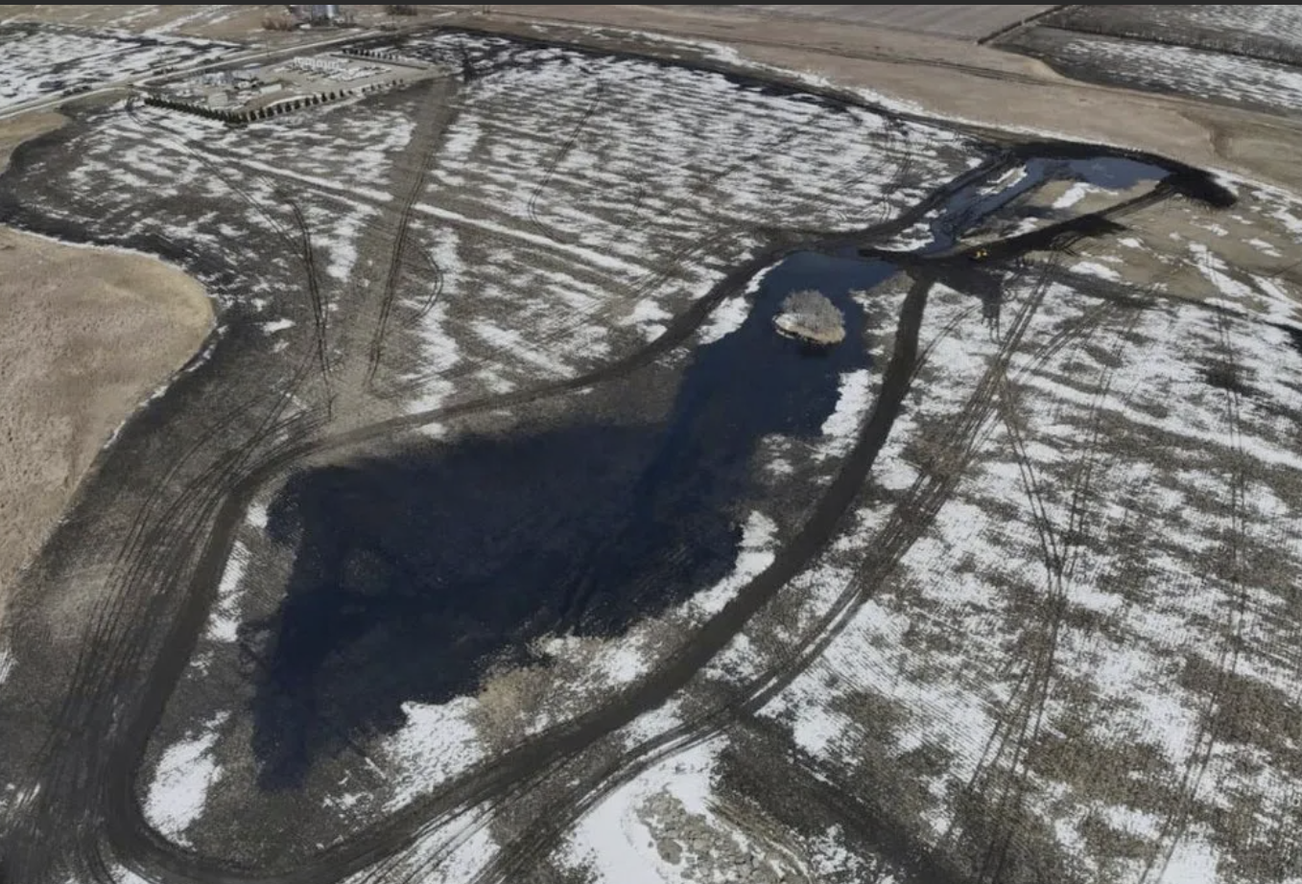
Agenda
Leak Detection SRP Overview
Current LD SRP Completion Roadmap
Current LD SRP Funding Roadmap
Status of Key Outcomes
Next Steps for the SRP

Slide 3

Leak Detection SRP Overview
This Strategic Research Priority closes the primary gaps in standardizing the way that technologies and methods for leak detection are validated and qualified for energy pipelines (gathering, transmission, and distribution), and their associated facilities.
Outcomes and Value to Industry
Improve detection, location, and quantification of leaks
Reduce the leak volumes/sizes
Improve confidence and reliability of these technologies
Reduce/eliminate failures/gaps within the technology
Impact regulations and recommendations for liquid and gas pipelines
Reduce workload for Operators, saving time, reducing risks and increasing safety
Ultimately, change the way operators manage their LDS technology and programs.
Stakeholders
Industry Improvement
Liquid Hydrocarbon Systems
Improve CPM system performance
Improve ELD, and RS, and Hybrid performance
Produce recommended practices, standards, and guidance documents
Comprehensive leak detection strategy for gas and liquids operators (internal/external)
Natural Gas Pipelines
Accelerated event identification through remote sensing
Application of continuous pipeline monitoring for gas transmission operations
Validation of technology capabilities and limitations
Regulators
Researchers
PRCI
PRCI
Greenhouse Gas Emissions Identification and Quantification for Natural Gas Pipelines
Industry guidance for continuous monitoring of facilities
Clarify capabilities and limitations of large area remote monitoring
Identify advanced leak detection technologies capably of accurate quantification of rates and leak location, with confidence
Improving characterization of release and emissions intermittency for detection and quantification
Operators
Service Providers

Slide 4
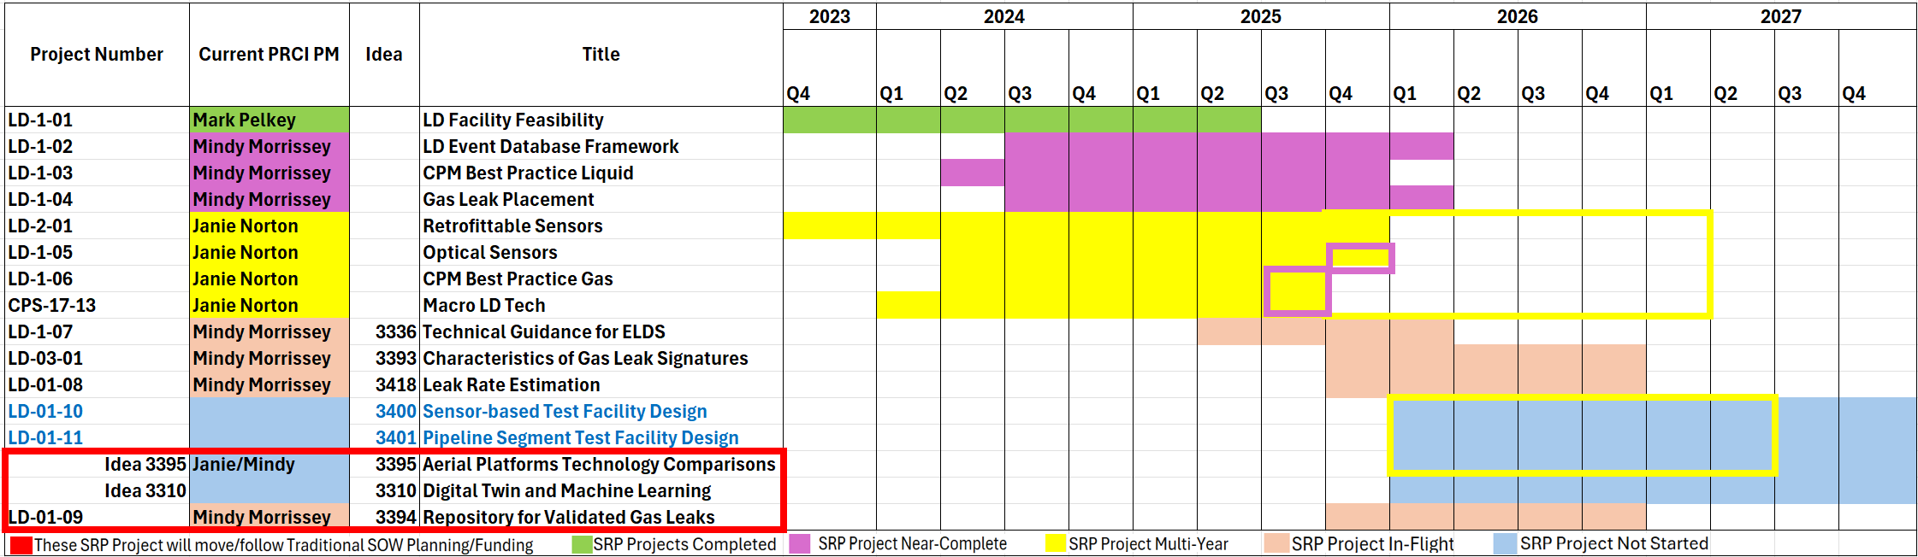
Current LD SRP Completion Roadmap

Slide 5
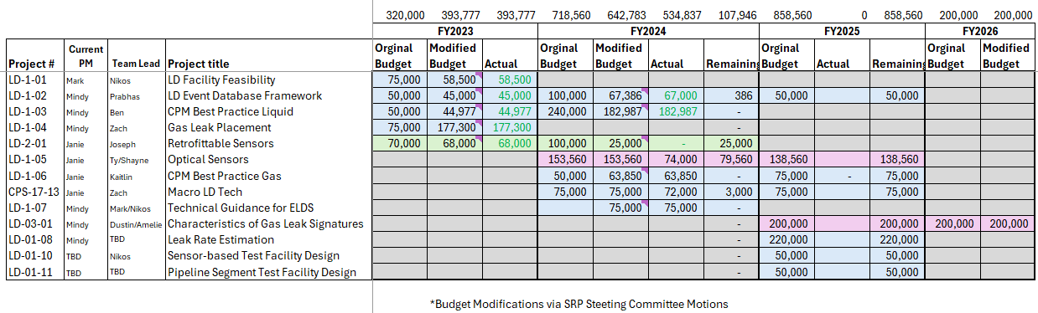
Current LD SRP Funding Roadmap

Slide 6
Key Outcomes of current LD SRP projects

Slide 7
LD-1-01 – Leak Detection Test Facility Feasibility Study
Project Status/Outcomes to Date
Posted Final Report (PR310-233903) on PRIME: Report.
Next Steps
Project Completed, submitted for report to be published.
Highlights numerous gaps in current leak detection testing facilities (10) capabilities (PRCI, METEC, SwRI, DNV, CFER, CTDUT, GTI, EERC,etc.),
Facility build details and cost estimates have been posted in the project folder, updates and tighter numbers would require more detailed design specs (Ideas 3400 and 3401 Phase-1).

Slide 8
LD-1-02 – Leak Event Database Framework
Project Status/Outcomes to Date
Framework process on database development is progressing.
Next Steps
Planning to tidy-up the Framework demo for October - date TBD.
Utilized ETL process, and queries are functional.
On Budget, with Extension.
Project is Near Complete.

Slide 9
LD-1-03 – CPM Best Practice for Liquids
Project Status/Outcomes to Date
Technical guidance document is in-progress.
Next Steps
Timely feedback is requested and appreciated; draft content is all posted on SharePoint.
Incorporating feedback received regarding Sections 4.3 (Accuracy and Repeatability of CPM Instrumentation) and 4.4 (Telecommunications and Networks Supporting CPM).
Project team is reviewing and providing feedback on Section 4.5 (CPM Performance Limitations).
On Budget, with Extension.
Project is Near Completed.

Slide 10
LD-1-04 – Gas Leak Sensor Placement
Project Status/Outcomes to Date
Presentation at last team meeting served as interim draft report.
Next Steps
Team is tasked to provide feedback on any additional incident characteristics for inclusion and regarding the final report outline.
On Budget, with Extension.
Incident data collection task complete and data is now being aggregated into an accessible database and formatted for query accessibility.
Model development has started and a list of topics to be addressed in the final report was reviewed - draft final report in- progress.
Project is Near Complete.

Slide 11
LD-2-01 – Retrofittable Sensors
Project Status/Outcomes to Date
Draft report in-progress.
Next Steps
Review Draft Report and Complete Project.
On Budget, with Extension.

Slide 12
LD-1-05 – Assessment of Optical Sensors
Project Status/Outcomes to Date
Draft final report vote is open until September 23rd.
Next Steps
Project is Near Complete.
On Budget, with Extension.
Webinar instructions have been sent.

Slide 13
LD-1-06 – CPM Best Practices for Natural Gas
Project Status/Outcomes to Date
Draft report has been updated with comments.
Next Steps
Project is Near Complete.
On Budget.
Webinar instructions have been sent.

Slide 14
CPS-17-13 – Testing Macro Leak Detection Technology
Project Status/Outcomes to Date
Draft report is open for vote, extended to September 24 due to only 20% votes received.
Next Steps
Project is Near Complete.
On Budget, with Extension.
Webinar instructions have been sent.
Selected Webinar with live Q&A.

Slide 15
LD-1-07 – CPM Best Practices for Natural Gas
Project Status/Outcomes to Date
Finalizing technology identification and literature review (stage 1)
Next Steps
Next phase will be technology assessment which will include a deeper dive into manufacturer specs and direct communications with vendors to validate findings and fill gaps with respect to the technologies identified in phase 1.
Targeted end of September to provide a draft to the project team for review and feedback.
On Budget.

Slide 16
LD-3-01– Characteristics of Gas Leak Signatures
Project Status/Outcomes to Date
Final draft RFP has been approved following updates to include clarification and a more detailed scope of expectations in support of project success.
Next Steps
Targeting bids back by October 31, 2025.
Following a grace period to allow team leads time for input, an email was sent to the entire project team for review and feedback on the RFP including a request for contractors for bidding.
Pending responses from the project team the RFP will be sent to contractors for bid solicitation.
Since this is a LD SRP that is being funded with money from the CPS TC they have requested an update on this project at the fall TC.

Slide 17
LD-1-08– Gas Leak Rate Estimation from Pipeline Defects
Project Status/Outcomes to Date
Currently holding sessions with the two vendors to clarify questions from the team before a final selection can be made.
Next Steps
Choose a Researcher.

Slide 18
LD-1-10 – Leak Detection Sensor-Based Technology Test Facility Design
Project Status/Outcomes to Date
Draft RFP’s developed by Mark to be reviewed by the team.
Next Steps
Waiting on EA feedback (meeting this week).
Identify external and internal leak detection testing needs as specified by PRCI staff and LD SRP membership.
Survey existing test facility operators to document current capabilities and opportunities for upgrades.
Identify gaps between needs and available test sites, opportunities to supplement or construct suitable facilities.
Develop a report for each project that allows the LD SRP and RSC to make informed decisions on future research, testing and facility investment.

Slide 19
LD-1-11 – Pipeline Segment Internal Leak Detection Technology Test Facility Design
Project Status/Outcomes to Date
Draft RFP’s developed by Mark to be reviewed by the team.
Next Steps
Waiting on EA feedback (meeting this week).
Identify external and internal leak detection testing needs as specified by PRCI staff and LD SRP membership.
Survey existing test facility operators to document current capabilities and opportunities for upgrades.
Identify gaps between needs and available test sites, opportunities to supplement or construct suitable facilities.
Develop a report for each project that allows the LD SRP and RSC to make informed decisions on future research, testing and facility investment.

Slide 20
Idea 3310 – Digital Twin and Machine Learning
Project Status/Outcomes to Date
Per EA decision, Idea 3310 will proceed as a traditional project, not under the LD SRP.
Next Steps
Idea to be included in the SOM TC Roadmap Prioritization process.
Idea will be slotted into the upcoming roadmap based on prioritization results at the Fall TC meeting.

Slide 21
Idea 3394 – Repository for Validated Gas Leaks
Project Status/Outcomes to Date
Per EA decision, Idea 3394 will proceed as a traditional project, not under the LD SRP.
Next Steps
Idea to be included in the SOM TC Roadmap Prioritization process.
Idea will be slotted into the upcoming roadmap based on prioritization results at the Fall TC meeting.

Slide 22
Idea 3395 – Aerial Platform Technology Comparisons
Project Status/Outcomes to Date
Per EA decision, Idea 3395 will proceed as a traditional project, not under the LD SRP.
Next Steps
Idea to be included in the SOM TC Roadmap Prioritization process.
Idea will be slotted into the upcoming roadmap based on prioritization results at the Fall TC meeting.

Slide 23


