Slide 2

Intelligent Pipeline Integrity Program
PRCI Fall Meeting of the Technical Committees
Nashville, TN
Wednesday October 22nd
Darren Schmidt, P.E.
Assistant Director for Energy, Oil & Gas

Slide 3
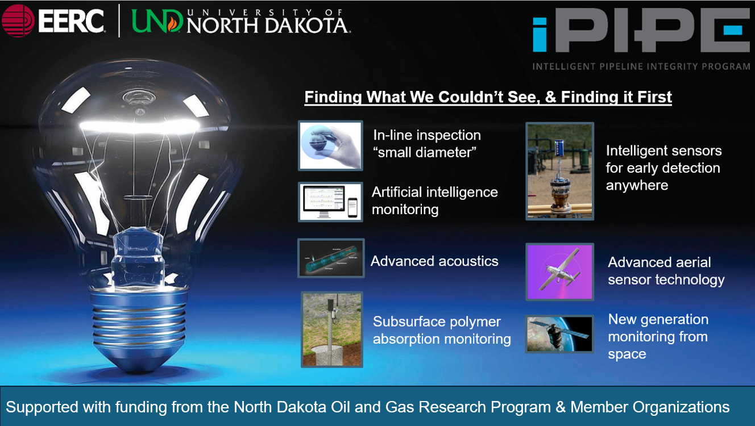

Slide 4
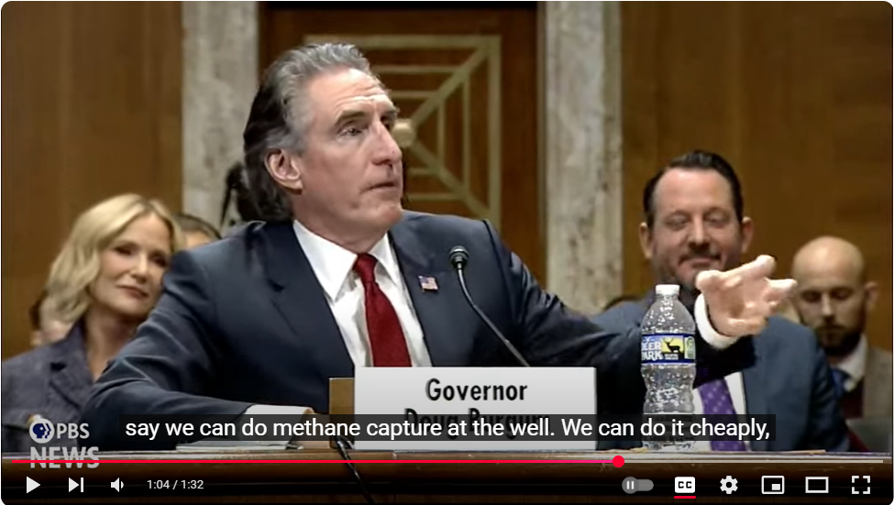
https://www.energy.senate.gov/services/files/879FAD20-CCAD-410A-9296-005E59584D5C
U.S. Secretary of the Interior, Doug Burgum
Confirmation Hearing January 16, 2025
(02:01:50) I mean, the amount of innovation that is occurring right now in the energy industry is unbelievable. It's as exciting as anything in tech that's going on. And so that's why I say innovation over regulation. We could solve these problems cheaper, faster, and quicker than we can through expensive and outdated regulations.

Slide 5
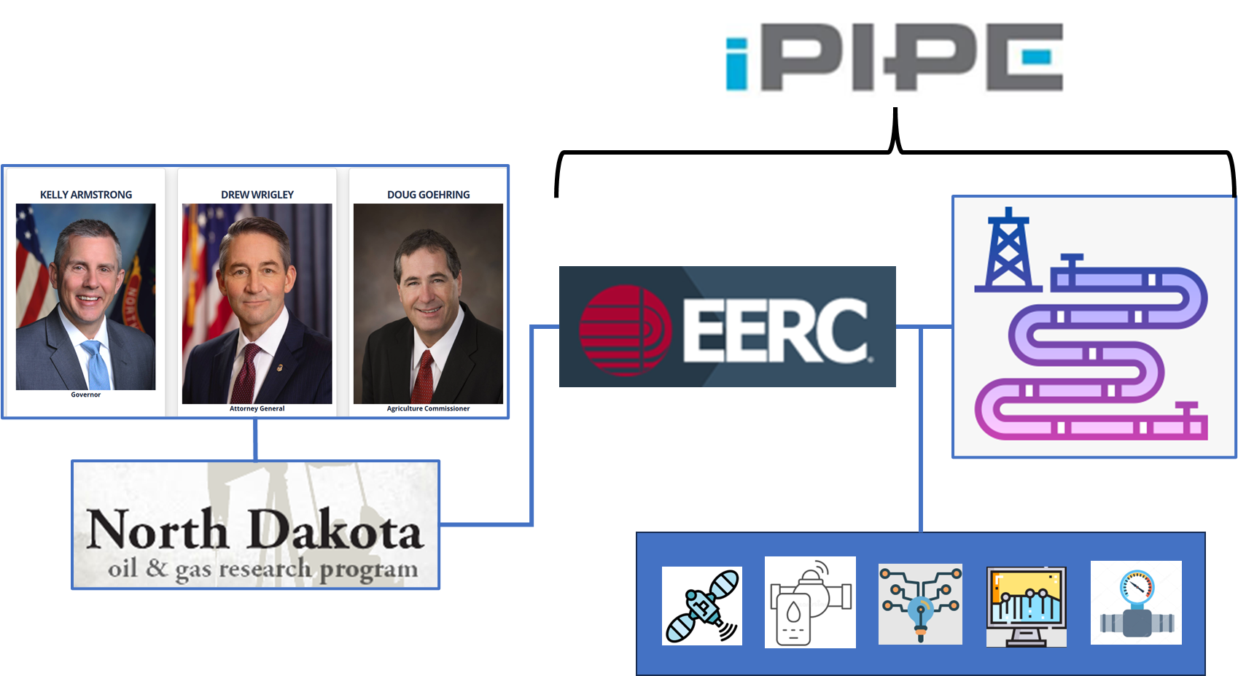
Collaboration

Slide 6
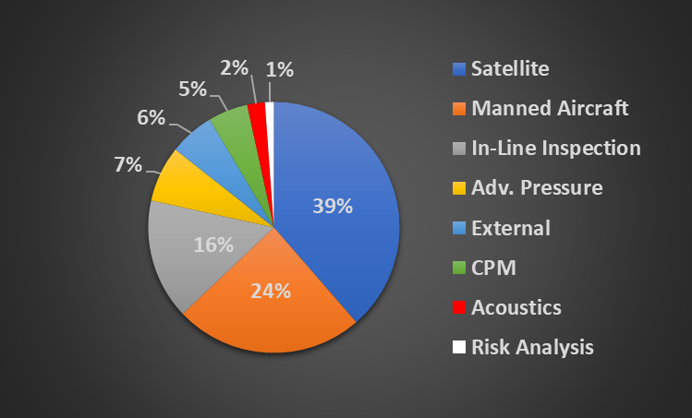
iPIPE Technology Investments
Computational Pipeline Monitoring (CPM)
Manned Aircraft include Methane Detection

Slide 7
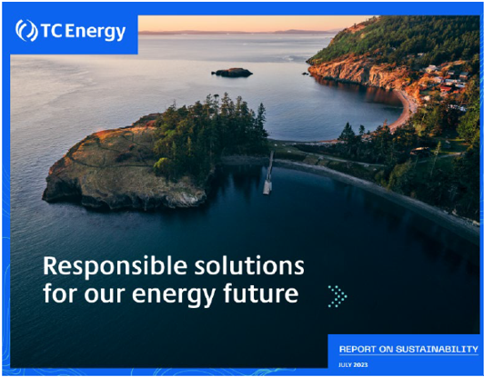
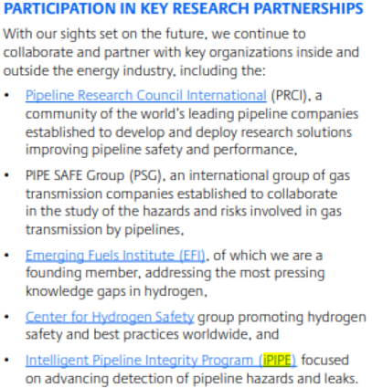
Member Recognition

Slide 8
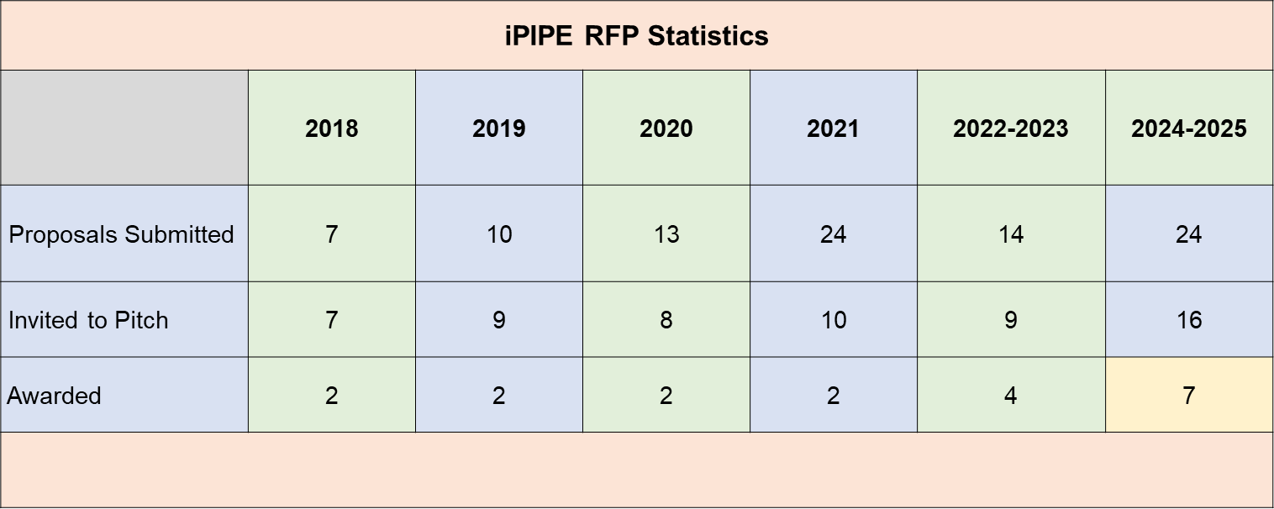
Technology Scouting: 170+ vetted, 19 projects

Slide 9
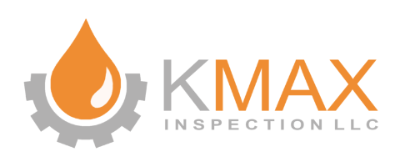




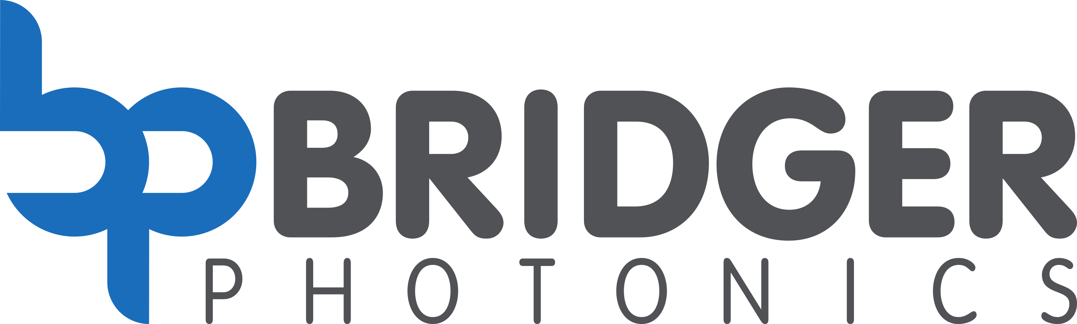


Current Projects
Prevention – ILI
Technology Advancement
External
Methane

Slide 10

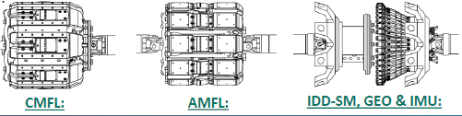
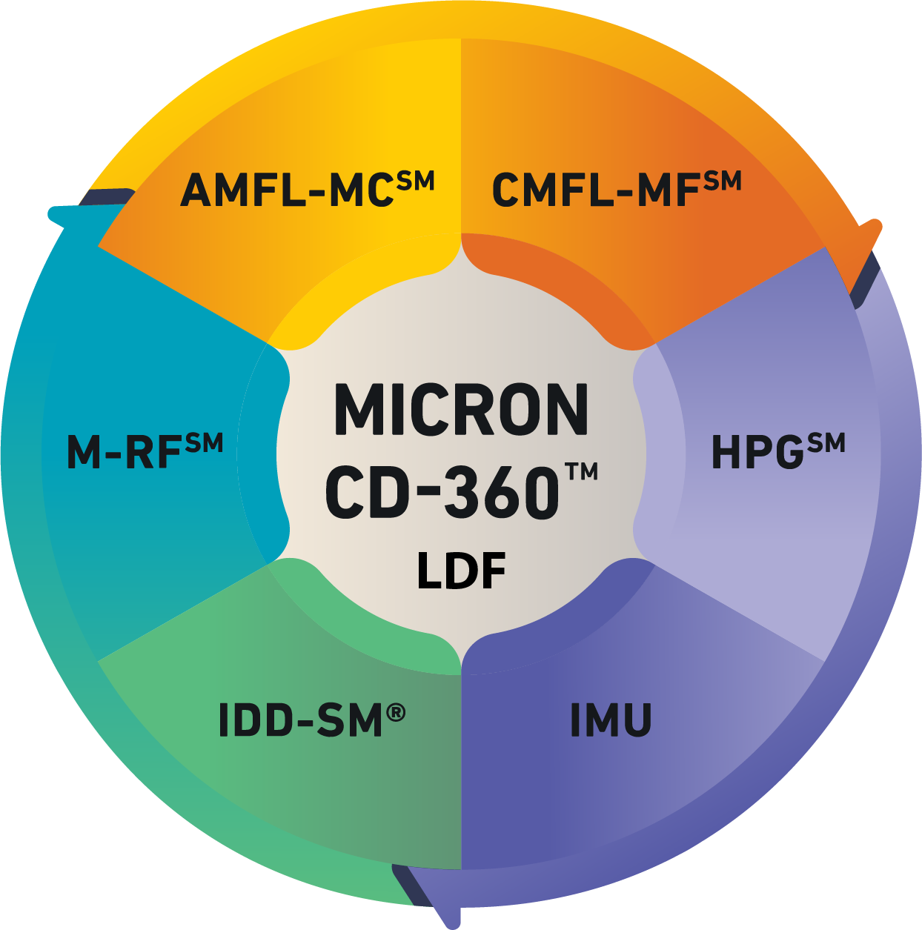
1000 s/in² 640 s/in²
Present capability
  Circumferential stress corrosion cracking (CSCC)
  Off-angle cracks (beyond ultrasonic visibility)
  Hook cracks & lack of fusion
  Axial cracks near the seam weld
Improved capability
  Axial Stress Corrosion Cracking Detection
  Develop a unique CMFL magnetizer in addition to the present Micron technology.
Objective: Gain the reliability of detection confidence in sizing of AXIALLY oriented cracks in the body of the pipe material.

Slide 11
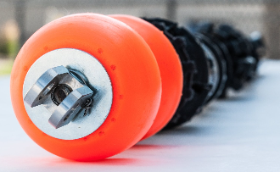
The proposed advancement is to overcome the limitations of 4-inch axial tools with a 4-inch circumferential tool (CMFL).
Objective: Develop and test a 4-inch circumferential magnetic flux leakage (CMFL) tool capable of inspecting 4-inch diameter pipelines.
Advancements & miniaturization of magnets and electronics have enabled axial ILI tools for 4-inch pipelines.
Axial MFL tool limitation: the detection, and sizing of long, narrow axially aligned pipeline anomalies such as seam defects, linear corrosion, or mechanical damage.
https://www.kmaxinspection.com/projects

Slide 12
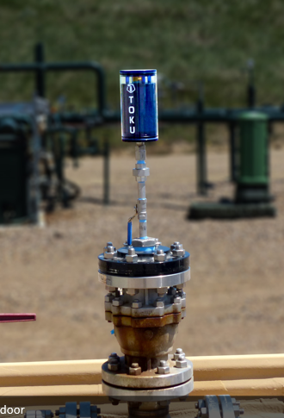
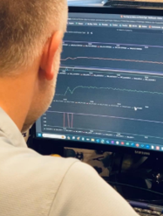
TOKU
Advanced pressure sensing per second, down to 0.01 psi.
Cloud data coupled with AI
Leaks can be detected and located anywhere within an instrumented system.
FLOWSTATE
Proven algorithms in CPM systems for advanced leak detection.
Now include produced water systems.
iPIPE is uniquely combining these two organizations and their technology for a field trial.

Slide 13
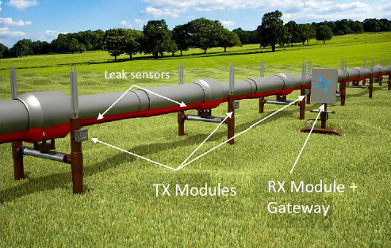
Polymer Absorption Sensor (PAS) technology
Distributed Smart Sensor Network (DSSN)
Enables the affordability of mass sensor arrays (50-100) covering 1000 ft between RX gateways.
Significant step-change in the affordability of external leak detection sensing.

Slide 14
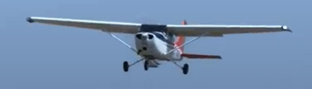
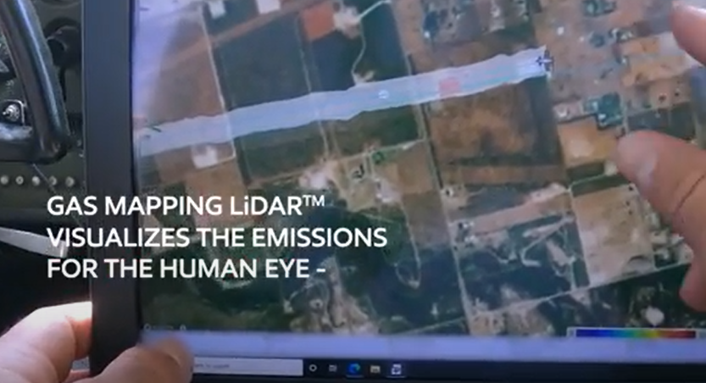
Aerial methane detection
Gas Mapping LiDAR
Working to improve:
  Waveform control electronics
  Optical transmitter
  Optical receiver
Objective: increased LiDAR signal strength to improve methane detection over snow cover.

Slide 15
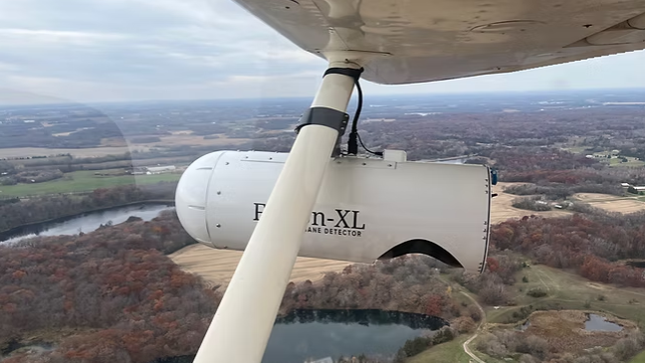
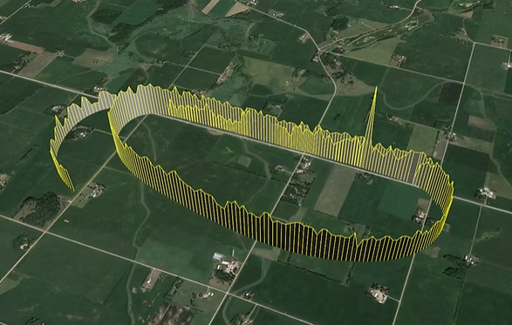
Tunable Diode Laser Absorption Spectroscopy (TDLAS).
Displays the real-time PPM-M concentration within the laser beam.
Objective: Develop and test methane quantification capability.
Laser curtain algorithm (LCA) applied when flying concentric circles around the methane plume.
Enables a 3D plume analysis.
Adopt from drones and adapt to aircraft.

Slide 16
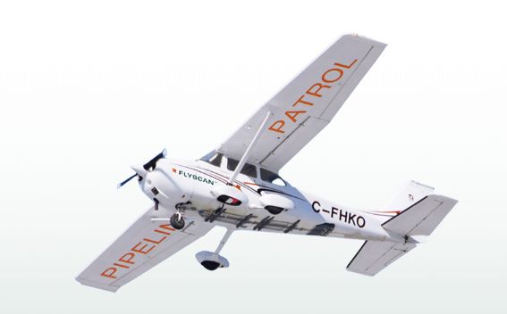
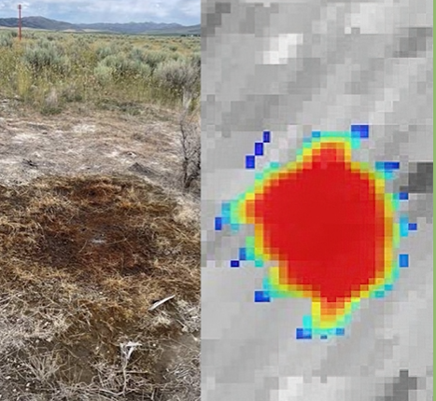
Objective: add methane capability to an existing pipeline RoW threat detection system for aircraft.
5 kg/hr capability
LiDAR
Develop, design, build, and test.
Present technology includes 3 RGB cameras, hyperspectral (SWIR) camera, inertial measurement unit (IMU), and range finder.
Threats, HC liquids, hazards, vegetation, change detection.

Slide 17
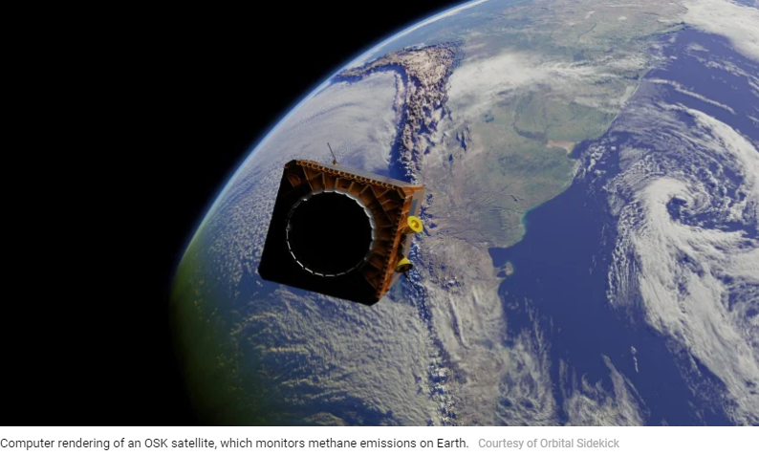
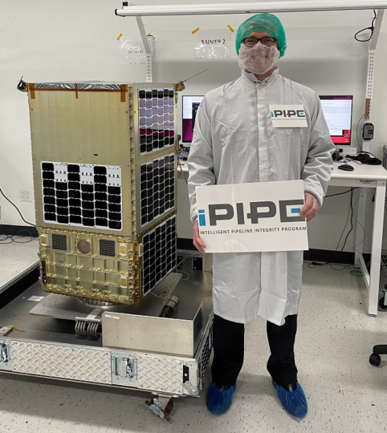
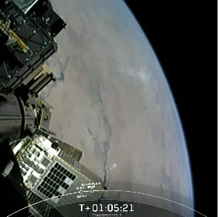
ORBITAL SIDEKICK

Slide 18
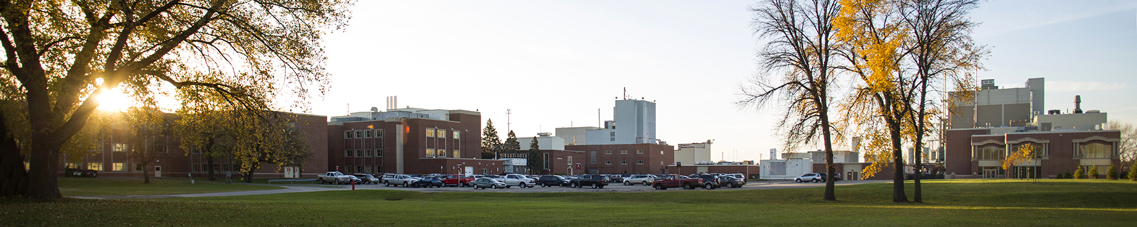
Energy & Environmental Research Center
University of North Dakota
15 North 23rd Street, Stop 9018
Grand Forks, ND 58202-9018
www.undeerc.org
701.777.5000
Darren Schmidt, P.E.
Assistant Director, Energy, Oil & Gas
eercinfo@undeerc.org
701.777.5000
THANK YOU
Critical Challenges. Practical Solutions.

