Slide 1
R&D-Based Decision Optimizer
Executive Assembly Meeting
Shahani Kariyawasam, Ph.D., P.Eng.
Executive Director, Knowledge Transfer
Nashville
Oct 22, 2025
Notes:
Story –
At REX 2025 at the Panel on AI – Michael Bellamy – presented some great R&D work Baker Hughes had performed using ML to specify ILI error in a defect specific manner – This was done 6 to 8 years ago. His main concern was that the R&D was done the technology was available for use, it reduced a significant number of digs (bringing great value) yet Adoption by industry was very poor! So he asked why ? Why are we not adopting valuable available R&D?
This is not an isolated case. Psqr model is another example.
We did go on to discuss how many operators;
1) firstly, do not have the decision framework/process/software to receive new technologies/methods/models - defect specific ILI error, Psqr cannot be readily adopted by many fitness for service processes or software.
2) The secondary reason is that many decision makers do not have a clear view of cost benefit – Is the effort and resources needed to implement the new technology worth the returns in value – in the reduction of digs?
3) Most operators do not have the people to build the required framework and communicate the cost benefit
This is the need we are trying to satisfy !

Slide 2

Value of R&D in Safety Decisions
Effect of R&D
Improve Input with better technologies (E.g., high resolution vs low resolution ILI)
Continuously improve engineering models, technologies, and processes (E.g., ILI error representation, corrosion growth process, assessment model, etc)
Ensure safety and reduce unnecessary actions, resource allocation - $$, time (E.g., number of digs, number of failures)
Input Data
Engineering Models
Technologies
Processes
Integrity Decisions ($$, Resources)
© 2025, Pipeline Research Council International
Notes:
Operators take - Many safety related technical decisions. Input data – that is processed using Eng Models, technologies, processes that lead to integrity decisions which cost operators $$ and resources.
R&D can improve the input data ( like using hires instead of low res ILI data) and ………..
One of the high budget critical decisions particularly for vintage pipelines is corrosion and crack ILI based dig decisions

Slide 3
Why are Valuable Improvements Not Always Adopted?
Issues | Solution
R&D address components of the decision-making system. Operators lack Systems/Framework to receive R&D. | Build flexible API based software system to integrate many subsystems and gain system reliability.
The benefit to the company (or engineer/leader) is not always clear | Software built to clearly communicate benefits with examples and refs
Operators are busy with operational demands- lack time to implement systems | Enable easy transparent implementation and upgrades
Not comfortable (and all may not have the expertise) with defending change to regulators or leaders | Provide basis for R&D, clear communication system, wide adoption and related PRCI documentation and support.
Notes:
another problem is that we don’t approach our R&D cohesively with a plan to have the results added to a decision tool. FFS tools are ad-hoc and commonly employ different research contractors who pick the software of their choice, sometimes not even producing a usable tool, just demonstrating the capabilities in modeling tools (e.g., Mathcad, Excel).

Slide 4
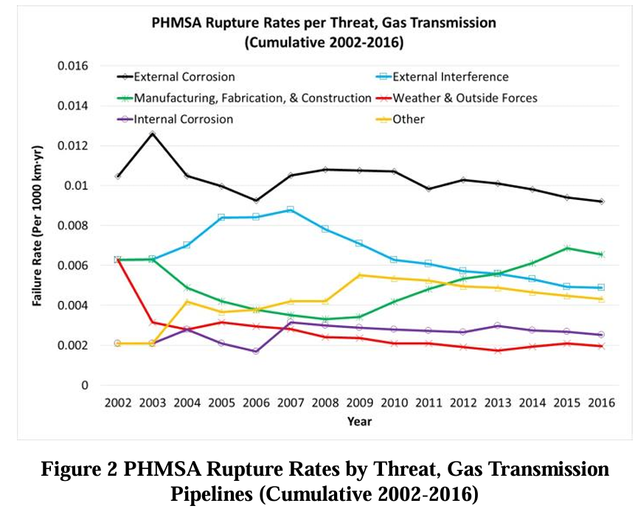
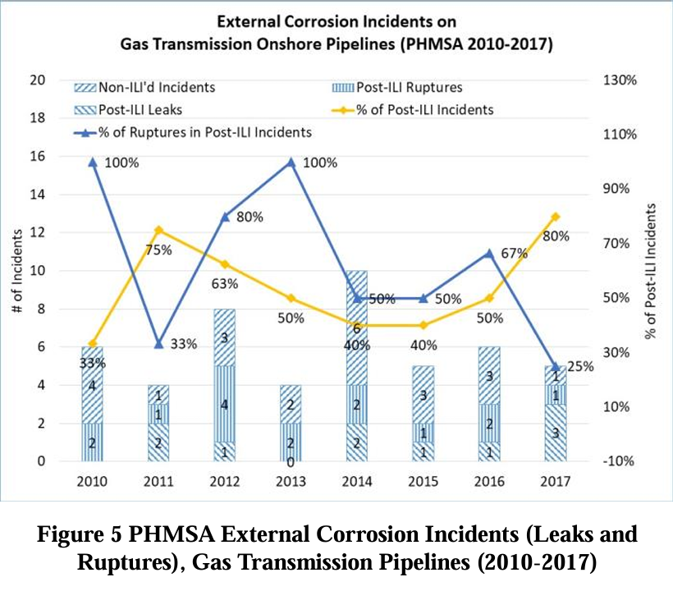
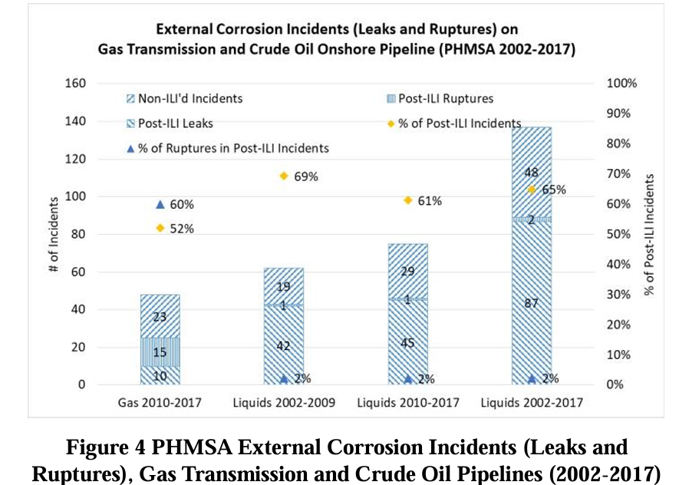
Corrosion (& Cracking) and Post ILI Failure Trends
Ref: Huang, T. and Kariyawasam, S. 2018. An ILI Based Program That Prevents Reoccurrence of Post ILI Failures Seen in Industry. Proceedings of the 2018 12th International Pipeline Conference, IPC2018-78604

Slide 5
Real Example – Effect of
Sharper Tools on Number of Digs

Slide 6
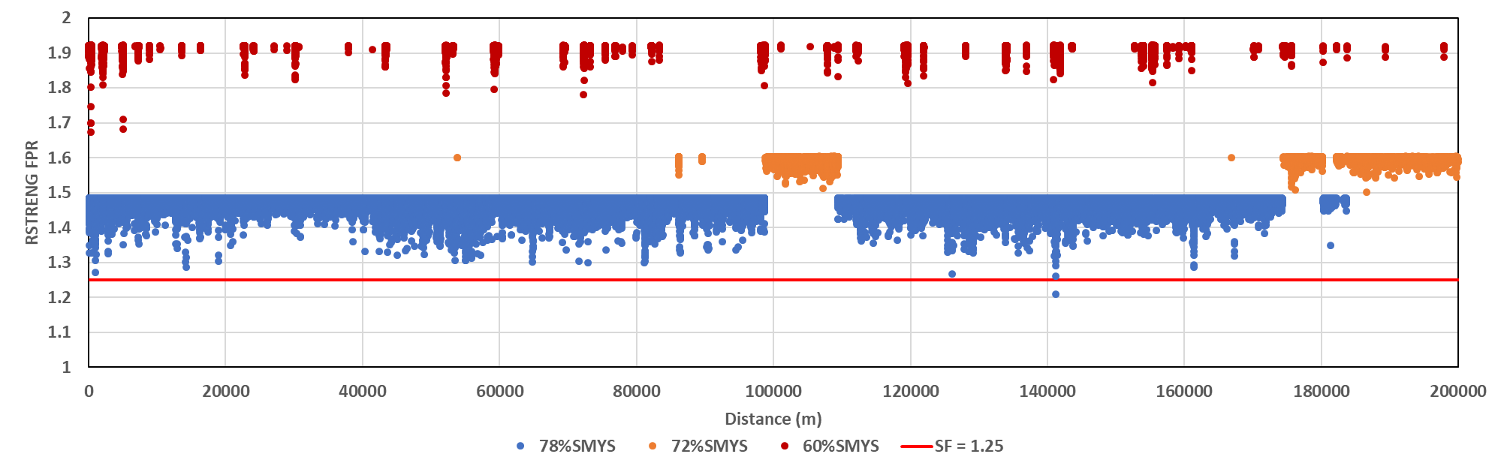
Example : 2017 ILI – Focus on Rupture Threat
Year 0, FPR_{RSTRENG} distribution
© 2025, Pipeline Research Council International

Slide 7
Decision Comparison –
Deterministic vs Probabilistic
Uncertainty
ILI Measurement Error
Growth Magnitude
Growth Granularity
Assessment Model
R&D
R&D
R&D
R&D
R&D
PIT – MB31G
& Cluster - Psqr
Probabilistic 1E-3
Deterministic, add 10% & 10 mm
Probabilistic, ± 10 %WT (10mm), 80% time
Signal-to-signal
run comparison
PIT specific growth
PIT – MB31G
Cluster – RSTRENG
Deterministic 1.25
Deterministic, add 20% & 20 mm
Probabilistic, ± 20 %WT (20mm), 80% time
No run comparison
Cluster specific growth
MB31G
B31G
Method | Threshold | Depth Error | Length Error | Model | Growth Rate |  | # Excavations in year |  |  |  |  |  |  | # reported features
 |  |  |  |  |  |  | 0 | 1 | 2 | 3 | 4 | 5 | 0~5 sum
Deterministic | 1.25 | Add 10% WT to depth |  | PIT MB31G Cluster RSTRENG | RunCom | Cluster-specific | 149 | 30 | 42 | 30 | 40 | 46 | 337 | 182619
 |  | Add 10% WT to depth & 10 mm to length |  |  |  |  | 169 | 34 | 29 | 37 | 54 | 53 | 376
Probabilistic | 1E-03 | +/-10 %WT (10mm), 80% time |  |  |  |  | 1 | 19 | 21 | 40 | 38 | 61 | 180
© 2025, Pipeline Research Council International

Slide 8
Decision Comparison –
± 10 %WT vs ± 20 %WT
Uncertainty
ILI Measurement Error
Growth Magnitude
Growth Granularity
Assessment Model
R&D
R&D
R&D
R&D
R&D
PIT – MB31G
& Cluster - Psqr
Probabilistic 1E-3
Deterministic, add 10% & 10 mm
Probabilistic, ± 10 %WT (10mm), 80% time
Signal-to-signal
run comparison
PIT specific growth
PIT – MB31G
Cluster – RSTRENG
Deterministic 1.25
Deterministic, add 20% & 20 mm
Probabilistic, ± 20 %WT (20mm), 80% time
No run comparison
Cluster specific growth
MB31G
B31G
Method | Threshold | Depth Error | Length Error | Model | Growth Rate |  | # Excavations in year |  |  |  |  |  |  | # reported features
 |  |  |  |  |  |  | 0 | 1 | 2 | 3 | 4 | 5 | 0~5 sum
Probabilistic | 1E-03 | +/-10 %WT (10mm), 80% time |  | PIT MB31G Cluster RSTRENG | RunCom | Cluster-specific | 1 | 19 | 21 | 40 | 38 | 61 | 180 | 182619
 |  | +/-20 %WT (20mm), 80% time |  |  |  |  | 1 | 430 | 154 | 246 | 273 | 409 | 1513
© 2025, Pipeline Research Council International

Slide 9
Decision Comparison –
RunCom vs No RunCom
Uncertainty
ILI Measurement Error
Growth Magnitude
Growth Granularity
Assessment Model
R&D
R&D
R&D
R&D
R&D
PIT – MB31G
& Cluster - Psqr
Probabilistic 1E-3
Deterministic, add 10% & 10 mm
Probabilistic, ± 10 %WT (10mm), 80% time
Signal-to-signal
run comparison
PIT specific growth
PIT – MB31G
Cluster – RSTRENG
Deterministic 1.25
Deterministic, add 20% & 20 mm
Probabilistic, ± 20 %WT (20mm), 80% time
No run comparison
Cluster specific growth
MB31G
B31G
Method | Threshold | Depth Error | Length Error | Model | Growth Rate |  | Critical features needed to be excavated in year |  |  |  |  |  |  | # reported features
 |  |  |  |  |  |  | 0 | 1 | 2 | 3 | 4 | 5 | 0~5 sum
Probabilistic | 1E-03 | +/-10 %WT (10mm), 80% time |  | PIT MB31G Cluster RSTRENG | RunCom | Cluster-specific | 1 | 19 | 21 | 40 | 38 | 61 | 180 | 182619
 |  |  |  |  | NO RunCom |  | 1 | 59 | 23 | 43 | 59 | 70 | 255
© 2025, Pipeline Research Council International

Slide 10
Decision Comparison –
RSTRENG vs Psqr
Uncertainty
ILI Measurement Error
Growth Magnitude
Growth Granularity
Assessment Model
R&D
R&D
R&D
R&D
R&D
PIT – MB31G
& Cluster - Psqr
Probabilistic 1E-3
Deterministic, add 10% & 10 mm
Probabilistic, ± 10 %WT (10mm), 80% time
Signal-to-signal
run comparison
PIT specific growth
PIT – MB31G
Cluster – RSTRENG
Deterministic 1.25
Deterministic, add 20% & 20 mm
Probabilistic, ± 20 %WT (20mm), 80% time
No run comparison
Cluster specific growth
MB31G
B31G
Method | Threshold | Depth Error | Length Error | Model | Growth Rate |  | Critical features needed to be excavated in year |  |  |  |  |  |  | # reported features
 |  |  |  |  |  |  | 0 | 1 | 2 | 3 | 4 | 5 | 0~5 sum
Probabilistic | 1E-03 | +/-10 %WT (10mm), 80% time |  | PIT MB31G Cluster RSTRENG | RunCom | Cluster-specific | 1 | 19 | 21 | 40 | 38 | 61 | 180 | 182619
 |  |  |  | PIT MB31G Cluster Psqr |  |  | 0 | 0 | 0 | 0 | 0 | 4 | 4
© 2025, Pipeline Research Council International

Slide 11
Decision Comparison –
PIT-specific vs Cluster-specific growth
Uncertainty
ILI Measurement Error
Growth Magnitude
Growth Granularity
Assessment Model
R&D
R&D
R&D
R&D
R&D
PIT – MB31G
& Cluster - Psqr
Probabilistic 1E-3
Deterministic, add 10% & 10 mm
Probabilistic, ± 10 %WT (10mm), 80% time
Signal-to-signal
run comparison
PIT specific growth
PIT – MB31G
Cluster – RSTRENG
Deterministic 1.25
Deterministic, add 20% & 20 mm
Probabilistic, ± 20 %WT (20mm), 80% time
No run comparison
Cluster specific growth
MB31G
B31G
Method | Threshold | Depth Error | Length Error | Model | Growth Rate |  | Critical features needed to be excavated in year |  |  |  |  |  |  | # reported features
 |  |  |  |  |  |  | 0 | 1 | 2 | 3 | 4 | 5 | 0~5 sum
Probabilistic | 1E-03 | +/-10 %WT (10mm), 80% time |  | PIT MB31G Cluster Psqr | RunCom | Cluster-specific | 0 | 0 | 0 | 0 | 0 | 4 | 4 | 182619
 |  |  |  |  |  | PIT- specific | 0 | 0 | 0 | 0 | 0 | 2 | 2
© 2025, Pipeline Research Council International

Slide 12

The Example Demonstrates
This same ILI run program based on inputs and sub-processes can safely give you anywhere from 2 to 1513 digs
Most commonly, sharper tools reduce large numbers of unnecessary digs however they may add a few more necessary digs
More precise methods (through R&D and improvement) give higher safety and economy – optimizing resources
Value of improvement can be demonstrated – to leadership and regulators
AXE
© 2025, Pipeline Research Council International

Slide 13

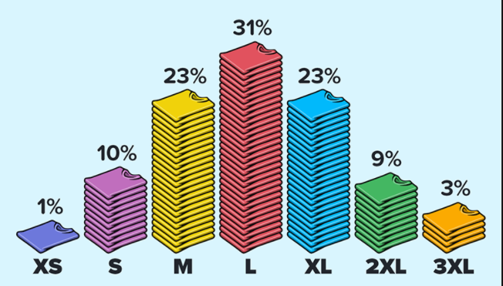
Why Sharper Tools Bring Performance and Economy
Max
Performance
Economy
Worst case
Without Data
Max
Smarter Tools
With Data
© 2025, Pipeline Research Council International

Slide 14
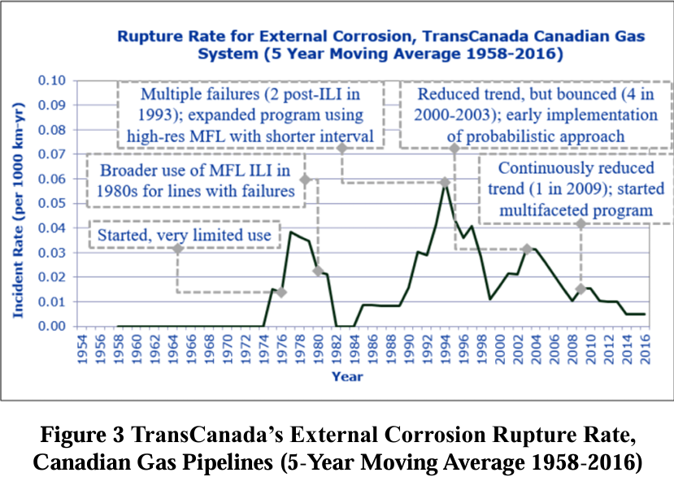
Corrosion Post ILI Failure Trends
Ref: Huang, T. and Kariyawasam, S. 2018. An ILI Based Program That Prevents Reoccurrence of Post ILI Failures Seen in Industry. Proceedings of the 2018 12th International Pipeline Conference, IPC2018-78604

Slide 15
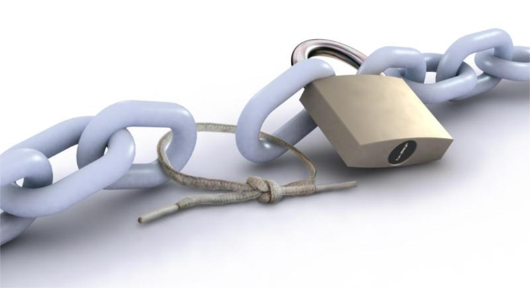
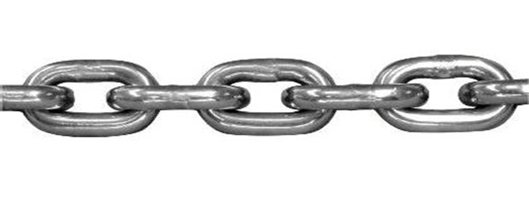
Moving from Components to System Reliability
Safety related decisions are made using many inputs & sub-processes (components).
Pipeline industry has developed these component improvements, which have been available for many years and decades.
Many operators use some of these component processes. But few use all system optimized combinations (from 1513 to 2 digs as appropriate) with consistent system reliability.
Other high reliability industries use system reliability methods which enable the full use of AI and data capability
A system is only as
strong as the weakest link
System optimization gives optimized
performance and economy
Consistent
system
reliability

Slide 16
Discussion
Many operators lack a framework/system in which to implement the R&D improvements and the tools to understand impact and defend to leaders/regulators.
Start with Corrosion Management System in 2026 (Cracks & Dents 2027-2028)
PRCI R&D-based Decision Optimizer will provide (Idea 5003):
  Analytical Software that compares R&D improvements to make optimum decision:
    Develops this System that is modular, able to adopt new models and AI+data driven processes
    Continuously updates the R&D results – as a simple to use tool
    Provides the many optional paths an operator can take (based on circumstances and need)
  Clear communication and defendable examples to demonstrate safety and value – with industry database for sandbox of ROI examples
  Plan to leverage existing software development expertise and modules for timely deliverables
Timely - Accelerated AI capability, Regulatory environment in US.

Slide 18

Moving Forward
R&D-based Decision Optimizer (RDO) is a systems approach to ensure components are integrated via data driven acceptable reliability levels and related optimized decisions for any safety-based decision process.
This will enable component research like ILI improvements to adopt AI and data driven improvements
First implementation - ILI based dig programs drive high budget &
can give the highest value to members – Corrosion and Cracks then others
Timely - Regulatory environment in US, etc. Accelerated AI capability.
© 2025, Pipeline Research Council International
Notes:
Regulatory environment is right
Baker Hughes

Slide 19
Backup

Slide 20
Call to Action
Developing business model
Initiating project in Q4 2025 – funding portal
Great support from industry leaders
Join the team to incorporate your needs and receive a tool that enables your leadership in 21 Century!

Slide 21
Purpose of this Presentation
High Value Initiative
Based on REX panel and other discussions
Growth in member support
Timely - regulatory environment, AI and data driven work
Opportunity to join team

