Slide 1
Pipeline Risk Management SRP
Justin Raimondi
Integrity Data Scientist, Kinder Morgan
OCTOBER-22-2025

Slide 2
Strategic Research Priority Value
SRP Goal: The SRP aims to enhance pipeline risk assessment and management through a technically robust, regulatory aligned, and unified guideline. By improving model transparency, data defensibility, and alignment with 49 CFR 192/195 expectations, this effort will enable more effective, focused, and risk-justified decisions within integrity programs; ultimately enhancing public safety, environmental protection, and operational efficiency.
The Problem: Despite regulatory mandates for risk-informed decisions, there is currently no widely accepted industry standard for modeling pipeline risk in a consistent, transparent, or auditable way. Existing models often struggle to balance conservatism with usability and frequently lack the precision needed to support actionable mitigation strategies or evolving threats.
Why It Matters: - $1M to $50M in avoided incident costs per event
- $60K+ saved per avoided or better prioritized dig
- Optimized integrity spending across hydrotests, ILIs, and repairs
- Greater risk reduction per dollar spent
Strategic Impact: This guideline will serve as a foundation for moving from prescriptive integrity practices to validated, performance-based programs, in full alignment with federal regulations and emerging best practices.

Slide 3
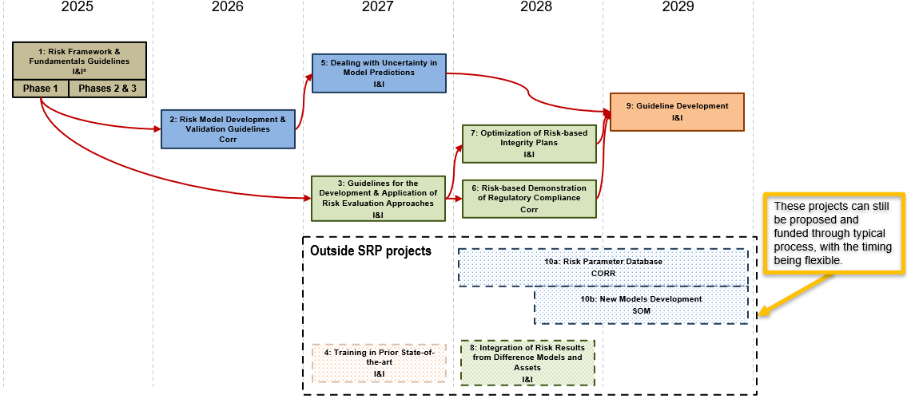
Roadmap
Notes:
Quick overview

Slide 4
2025 and 2026 Projects
2025 - Risk Framework & Fundamentals Guidelines
  Scope
    Develop a list of risk related terms and their definitions based on a literature review
    Conduct a literature review on probabilistic, quantitative, semi-quantitative, qualitative, subjective, and objective risk models, as well as associated risk measures
    Develop a guideline focusing on the benefits, limitations, available risk acceptance criteria formats (not values or levels), and utility or application of each risk model and measure type
  The project kicked off in July and will continue through the end of 2026
2026 - Risk Model Development & Validation Guidelines
  Scope
    Guidelines on identification of primary applicable threats and how to identify and use relevant data to develop and validate risk models
    Provide a consistent and robust methodology for producing comprehensive and validated risk models
    Provide a suite of tools that can be used to better analyze the effectiveness of the existing and potential safeguards from a risk modeling perspective
  The RFP is out, and the project will begin in Q1 2026
Notes:
Looking for members outside of the core group that has been involved. Risk is relevant to every committee and it’s great to have outside opinions. Want to make sure the guideline has value to every committee. Looking for cross-committee expertise to improve the projects.

Slide 5
2027 Projects
2027 – Dealing With Uncertainty in Model Predictions
  Develop methods to characterize the confidence level associated with risk estimates obtained from different risk models, as a function of the uncertainties associated with the modeling approach and the quantity and quality of model inputs
2027 – Guidelines for the Development & Application of Risk Evaluation Approaches
  Establish methodologies and provide guidance for developing and applying risk evaluation approaches and criteria for safety and environmental risks
  Provide a robust recommended practice on the fundamentals, format, and application of risk evaluation approaches and criteria that can be used by stakeholders (such as regulators, industry organizations, or individual operators) to develop their own risk evaluation methodologies
    Covers data sources needed in addition to providing example applications for overall risk, as it varies across a pipeline, and for individual threats
    Accounts for the cost of risk reduction
    Will include an approach for converting risk criteria into reliability-based criteria using simplified consequence modeling

Slide 6
2028 Projects
2028 – Optimization of Risk Based Integrity Plans
  Develop guidance for using the results of risk assessment to make optimized integrity management plans for defect management and damage prevention
  Will include cost optimization approaches, that are aligned with risk criteria and meet regulatory requirements, for repair schedules, inspection intervals, detailed third-party damage prevention plans, and other integrity needs
2028 – Risk Based Demonstration of Regulatory Compliance
  Develop guidelines for applying risk-based methods in engineering assessments as allowed or required by regulations
    Based on industry data that will be collected
  Provide guidance on conducting risk-based assessments to satisfy regulatory-related topics, including data requirements, applicable models, assessment outcomes, and rationale for demonstrating compliance with the regulatory requirements

Slide 7
2029 Capstone Project
2029 – Guideline Development
  Coordinate and combine deliverables from selected pipeline risk management SRP projects to produce a unified risk guideline document that is suitable for publication by a recognized standards development organization
  Will combine guideline documents and working examples from the previous projects while filling in any gaps to ensure coherence and consistency
  Will support the recommended practice adoption effort started in the first, 2025 project

Slide 8
Questions?
Contacts:
Project leads:
Justin Raimondi, Justin_Raimondi@kindermorgan.com
Chance Wright, Chance_Wright@tcenergy.com
Project manager:
Jim Wayman

