Slide 1

INGAA Foundation Research Updates
Michael Istre, PE, PMP
Director of Research and Project Management

Slide 2
Who is the INGAA Foundation?
Our Membership
Often referred to and INGAA's "think tank"
Open to natural gas and complementary clean energy companies that support the natural gas infrastructure value chain.
  Currently 178 Member Companies
Associations | 5 |  | Pipeline Manufacturing/Svc | 19
Consulting/Research | 32 |  | Pipeline Operators | 18
Construction | 50 |  | LNG | 1
Engineering | 25 |  | Integrity Management | 9
Equipment Manufacturing | 15 |  | Insurance | 2
Legal Services | 1 |  | Complementary Clean Energy | 1
Notes:
Roughly 10% operator. The demographic mix has been consistent over the last two years.
We would love to have more operators join the foundation – creates even more opportunity for alignment

Slide 3
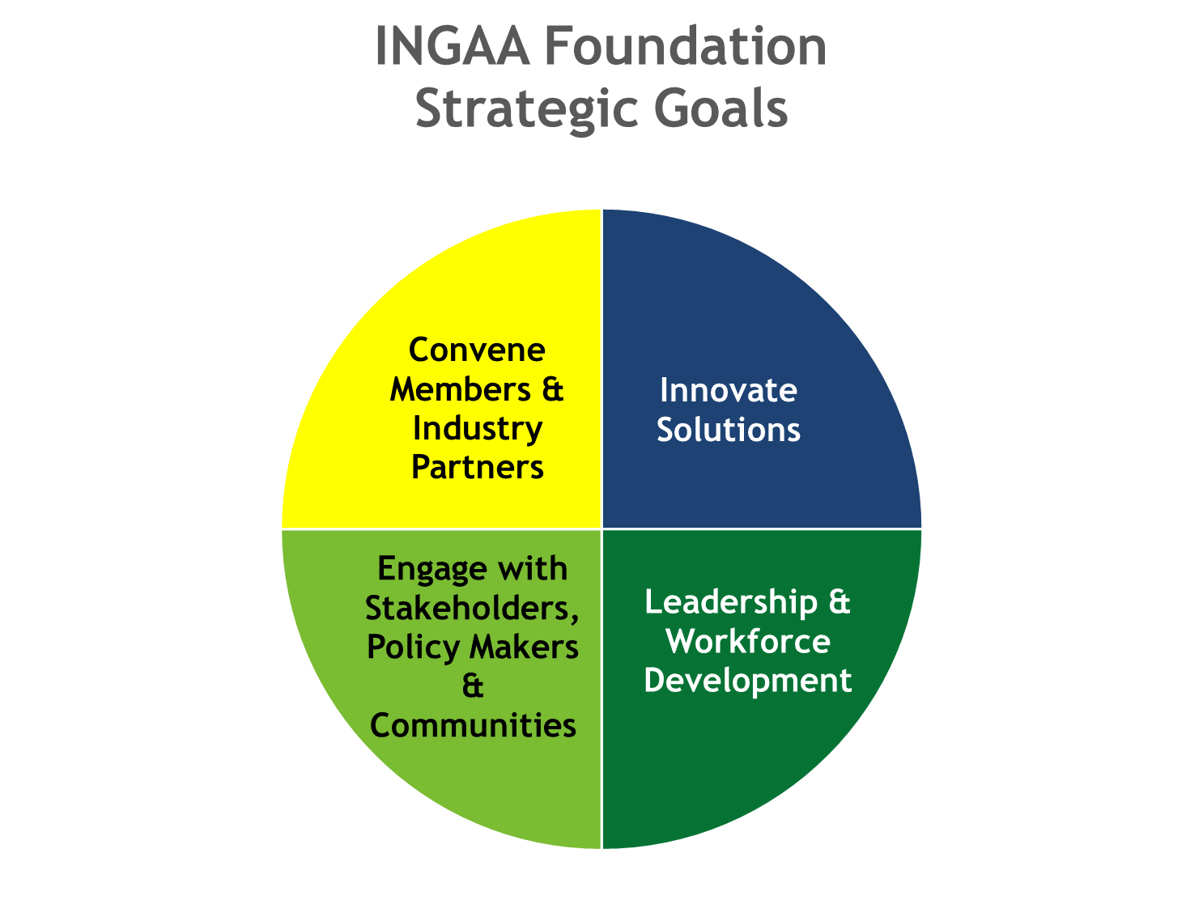

Slide 4

INGAA Foundation Study Criteria
Is this work compatible with our Mission and Vision?
Is the interest of the membership in this work sufficiently broad?
Is this new information?
Is the Foundation the right organization to perform this work?
Is this work Mission Critical?

Slide 5
2025 INGAA Foundation Projects
Project | Category | Oversight Committee
Youth Engagement Curricula Alignment | Other | OWL
Cyber-informed Engineering Workshop | Workshop | Q&I
Constructing Parallel Pipelines | Report | Q&I
Emissions Mitigation Considerations | Report | Environment
Geohazard Workshop | Workshop | Q&I
Workforce Demographics Study | Report | OWL
Industry Capacity Assessment | Report | Q&I
Other Efforts & Annual Workshops
Environmental Forum P3 (formerly FERC 201) | Workshop | Environment
Pipeline Construction Safety Roundtable (PCSR) | Workshop | Safety
Midstream Infrastructure Report | Report | ExCo
Mentorship Program | Other | WOL

Slide 6
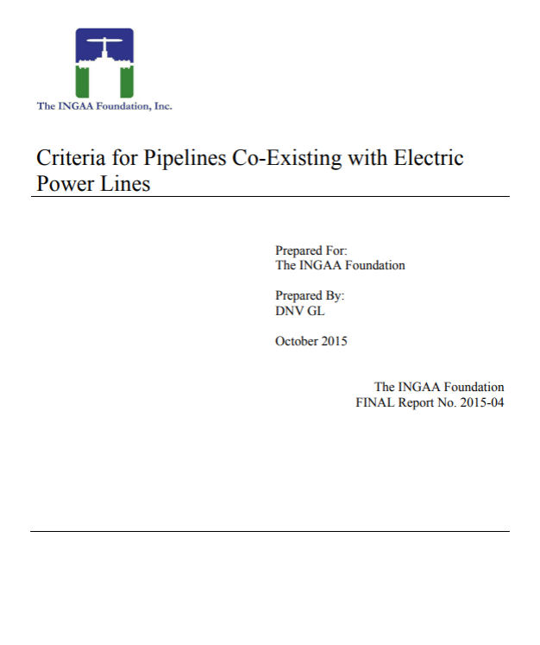
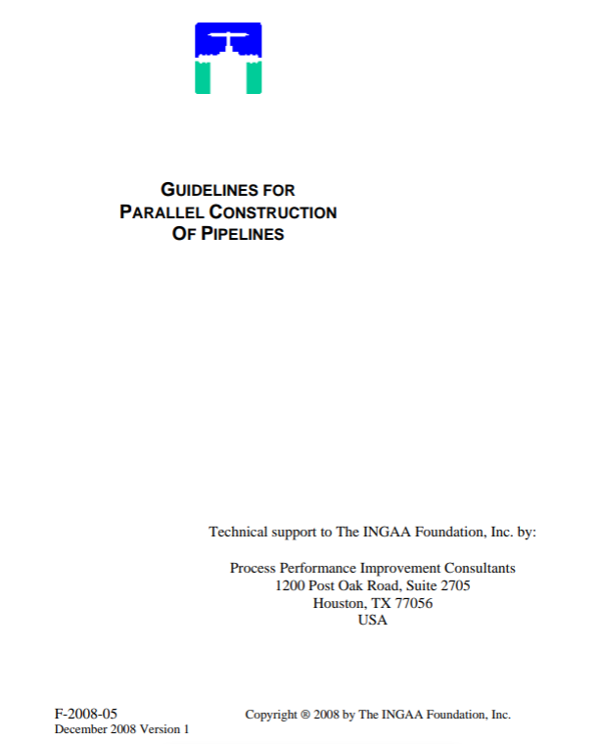
Construction of Parallel Pipelines
Update to the 2008 and 2015 guidelines
Utilizing a survey of INGAA operators to identify gaps and current best practices
Expected release end of year

Slide 7
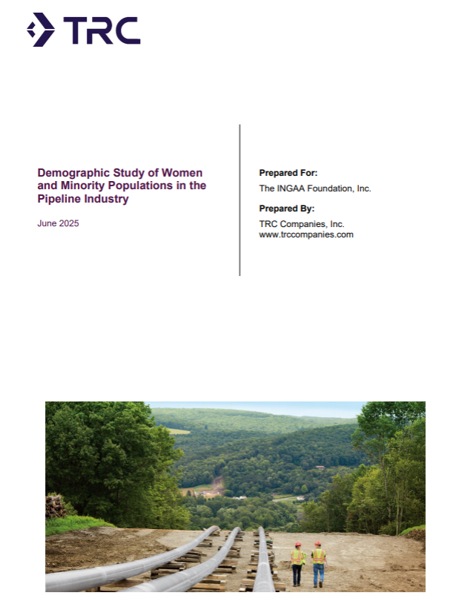
Workforce Demographic Study
Gender disparities remain prominent in the natural gas and pipeline industry workforce, where men continue to make up the majority of the workforce across nearly all age groups and regions.
Age remains a defining characteristic of the natural gas workforce, where despite efforts to attract younger talent, the industry remains heavily concentrated in middle aged groups.
Though the workforce is predominately White across all age groups there are slow but noticeable shifts toward greater diversity, particularly among younger workers.
Top recruitment practices include partnerships with educational institutions, trade schools, organizations that serve specific populations, online recruitment, apprenticeship programs, and events.

Slide 8
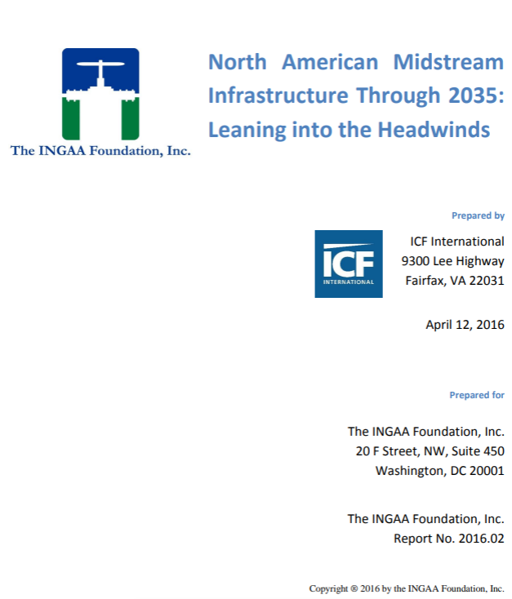
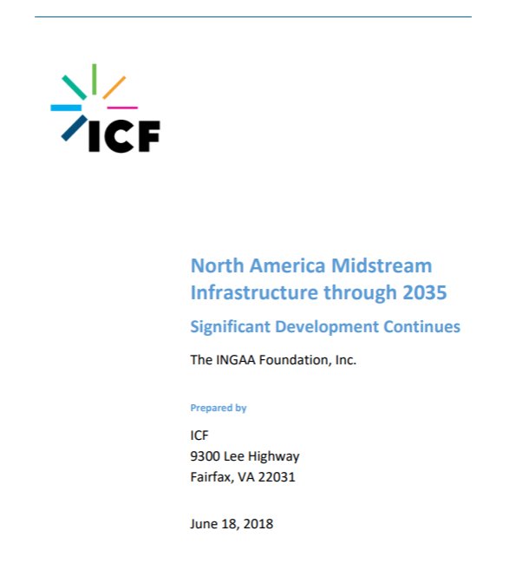
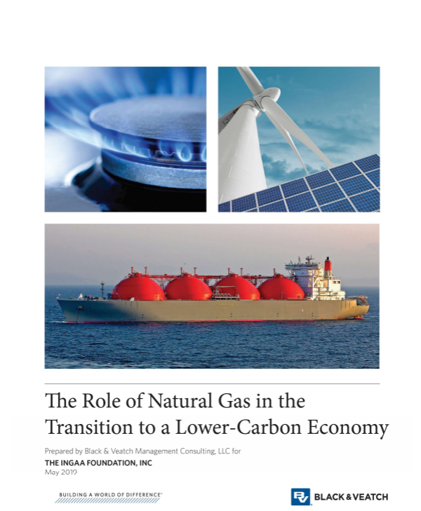
Midstream Infrastructure Report
The Foundation will publish the next iteration of the Midstream Infrastructure Report in 2025
Awarded to a consortia of University of Houston, Wood, and ESMIA
This version expands the midstream definition to include CCUS and other emerging fuels like hydrogen and ammonia
This version will also quantify operation and maintenance costs associated with new safety regulations, i.e., Gas Mega Rule, coming in effect in the short term

Slide 9

Contractor Capacity Project
Out of cycle project
Attempting to quantify the capacity of the midstream supply chain
  Manufacturing
  Engineering
  Construction
University of Houston engaged to survey the industry
Expect to have results by end of year

Slide 10
2025 Outlook: The Foundation on the Move!
Natural Gas 101 with Natural Allies for Clean Energy Future & INGAA
2025 Capitol Hill Showcase with INGAA
  2019 Event focused on inline inspection
  2023 Event focused on the pipeline life cycle
  2025 Event will focus on technologies used in the construction and operation of pipelines (October 29)
Hosted the Environmental Forum P3 (formerly FERC 201)
Socializing and Updating of Toolkits
  Advocacy Youth Toolkit
  Agency Engagement Outreach Toolkit

Slide 11
Planning for 2026 Projects
Short Title
Evaluating the Most Impactful Areas for AI Integration
Workforce Development & Outreach Opportunities
VR Headsets and Learning Module Library
Dig Optimization Study
Best Practices for the Security & Safety of Field Workers
What to Expect on a Pipeline ROW (update to Construction Primer)
Coating evaluation surveys
Compressor Seal & Rod Packing Study
INGAA Foundation Members ESG Training

Slide 12
Thank You
Michael Istre, PE, PMP
Director of Research and Project Management
mistre@ingaa.org

